Slide 1
STAT 240 Review Session
Prepared by: Cameron Jones
Fall 2023

Slide 2
Unit 2: Data Visualization

Slide 3
Unit 2: Data Visualization
Which of the following geometries require TWO variables? (choose all that apply)
geom_bar
geom_col
geom_histogram
geom_density
FA23

Slide 4
Unit 2: Data Visualization
Which of the following geometries requires TWO variables?
geom_bar
geom_col
geom_histogram
geom_density
Explanation:
Geom_bar automatically counts and plots the occurrences of a single categorical variable.
Geom_histogram automatically “bins” and plots the counts of occurrences of a single numeric variable.
Geom_density automatically produces a smooth curve similar to a histogram encoding the number of occurrences of a single numeric variable.
FA23

Slide 5
Unit 2: Data Visualization
You wish to visualize the distribution of Temperature (continuous) within each of 12 months. Should you facet by Temperature or Month?
FA23

Slide 6
Unit 2: Data Visualization
You wish to visualize the distribution of Temperature (continuous) within each of 12 months. Should you facet by Temperature or Month?
Explanation: One should facet by the categorical variable Month. Faceting generates a plot for each unique value of a variable, so it should be applied to categorical variables only.
FA23

Slide 7
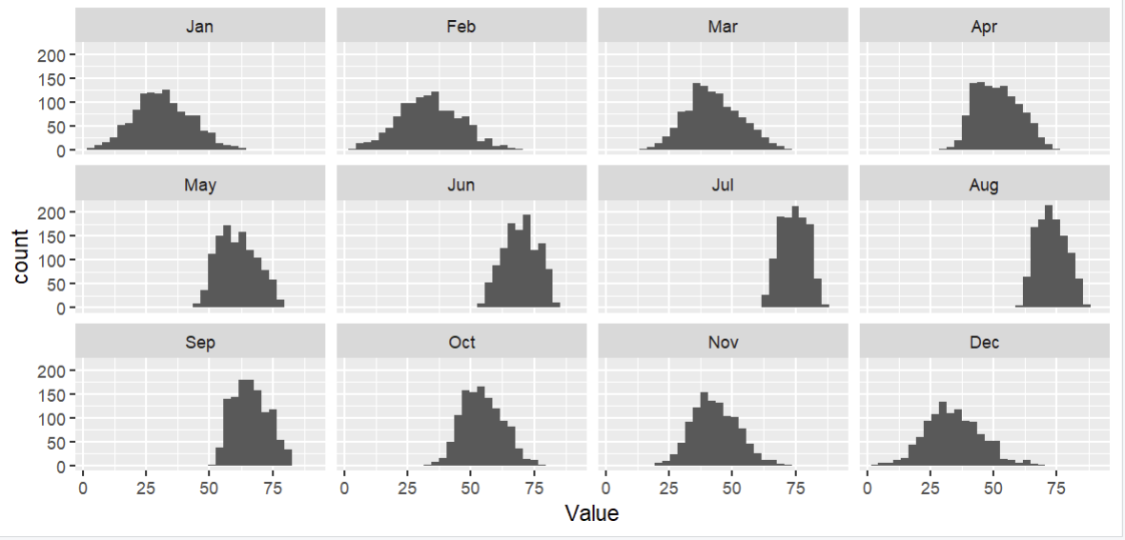
Unit 2: Data Visualization
Faceting Example
FA23

Slide 8
Unit 3: Dplyr

Slide 9
Unit 3: dplyr
Which of these commands may behave differently when preceded by group_by(something)? (choose all that apply)
select()
mutate()
slice_max()
summarize()
FA23

Slide 10
Unit 3: dplyr
Explanation: select() just keeps columns.
In mutate() and summarize(), expressions like mean() or n() will be evaluated at the group level if applicable, and over the entire dataframe otherwise.
Slice_max()with n=3 will give you 3 total rows without grouping, and 3 for each group with grouping
Which of these commands may behave differently when preceded by group_by(something)?
select()
mutate()
slice_max()
summarize()
FA23

Slide 11
Unit 3: dplyr
“myData” has 50 rows, and a categorical variable “group” which has 5 different values. How many rows will the result of this command have?
myData %>% group_by(group) %>% mutate(nRows = n())
FA23

Slide 12
Unit 3: dplyr
“myData” has 50 rows, and a categorical variable “group” which has 5 different values. How many rows will the result of this command have?
myData %>% group_by(group) %>% mutate(nRows = n())
Explanation: It will still have 50! mutate() always just adds a column, the group_by() only affects the values it puts in that column.
FA23

Slide 13
Unit 3: dplyr *
“df1” has 5 rows, and “df2” has 4 rows; they have a variable in common, and 3 rows each which would automatically match.
Rank the following by how many rows the resulting dataframe would have. (least -> most)
left_join(df1, df2)
Right_join(df1, df2)
Inner_join(df1, df2)
Full_join(df1, df2)
FA23

Slide 14
Unit 3: dplyr *
“df1” has 5 rows, and “df2” has 4 rows; they have a variable in common, and 3 rows each which would automatically match.
Rank the following by how many rows the resulting dataframe would have. (least -> most)
left_join(df1, df2)
Right_join(df1, df2)
Inner_join(df1, df2)
Full_join(df1, df2)
Explanation:
inner_join keeps all rows which match in both dataframes (3). Right_join keeps only the rows in the second dataframe (4). Left_join keeps only the rows in the first dataframe (5). Full_join keeps all rows in both frames (3 that match, 2 others from df1, 1 other from df2 = 6)
FA23

Slide 15
Units 4/5: Lubridate + Pivoting

Slide 16
Units 4/5: Lubridate + Pivoting
month(ydm(“2002-1-2”), label = TRUE) would return what?
1
Jan
2
Feb
FA23

Slide 17
Units 4/5: Lubridate + Pivoting
month(ydm(“2002-1-2”), label = TRUE) would return what?
1
Jan
2
Feb
Explanation:
The internal date is “y” (2002, the year) “d” (1st of the month), “m” (2nd month, February).
Extracting the month from February 1st, 2002 with label = TRUE gives “Feb” instead of 2.
FA23

Slide 18
Units 4/5: Lubridate + Pivoting *
Which of these statements are true about applying pivot_longer to a dataframe? (choose all that apply)
It can decrease the number of rows from what it was before.
It can increase the number of rows.
It can decrease the number of columns.
It can increase the number of columns.
FA23

Slide 19
Units 4/5: Lubridate + Pivoting *
Which of these statements are true about applying pivot_longer to a dataframe? (choose all that apply)
It can decrease the number of rows from what it was before.
It can increase the number of rows.
It can decrease the number of columns.
It can increase the number of columns.
Explanation:
Pivot_longer() takes X columns and spreads them out across two columns and X rows. The dataframe gets longer vertically (more rows) and narrower horizontally (less columns).
The question is worded like this because if you only pivot two columns, the number of columns will technically stay the same.
FA23

Slide 20
Units 4/5: Lubridate + Pivoting
myData currently has two rows for every U.S. state (100 total) (variable name state); one row representing the married people in that state, and one row representing non-married people, indicated by the variable marriageStatus. There is a column income which stores the average income of the people in that state-marriage combination. Write out the command which would transform myData into a dataframe with one row for every state, and a column each for avg. income among married and non-married people.
FA23

Slide 21
Units 4/5: Lubridate + Pivoting
myData currently has two rows for every U.S. state (100 total) (variable name state); one row representing the married people in that state, and one row representing non-married people, indicated by the variable marriageStatus. There is a column income which stores the average income of the people in that state-marriage combination. Write out the command which would transform myData into a dataframe with one row for every state, and a column each for avg. income among married and non-married people.
myData %>% pivot_wider(
names_from = marriageStatus, values_from = income)
We want to take the two rows for each state, defined by marriageStatus, and pivot them wider into one row for each state with two columns; the names of those columns will represent married & non-married respectively, and their values will come from the old income column.
FA23

Slide 22
Unit 6: Stringr

Slide 23
Unit 6: Stringr *
Match these stringr commands to the type of object they return.
Str_detect
Str_extract
Str_sub
Str_count
Logical (T/F)
Numeric
String
FA23

Slide 24
Unit 6: Stringr *
Match these stringr commands to the type of object they return.
Str_detect: Logical. T/F showing if your pattern is in the target string.
Str_extract: String. Returns the actual string that matched your pattern, NA otherwise.
Str_sub: String. Allows you to “slice” sections out of a string.
Str_count: Numeric. Counts number of times your pattern appears in the target strong.
FA23

Slide 25
Unit 6: Stringr
Fill in the following expression, which filters the dataframe myData by the content of the column word, to KEEP those rows where word ENDS with exactly: one or more of the letter “s”, then a digit, then the end of the string.
myData %>% filter(str_detect(word, “???”))
FA23

Slide 26
Unit 6: Stringr
Fill in the following expression, which filters the dataframe myData by the content of the column word, to KEEP those rows where word ENDS with exactly: one or more of the letter “s”, then a digit.
myData %>% filter(str_detect(word, “???”))
Explanation:
“s+\\d$”
Or
“s+[:digit:]$”
The “+” means match the previous token, which was “s”, one or more times. \\d or [:digit:] means any digit, $ means end of string.
FA23

